Slide 1
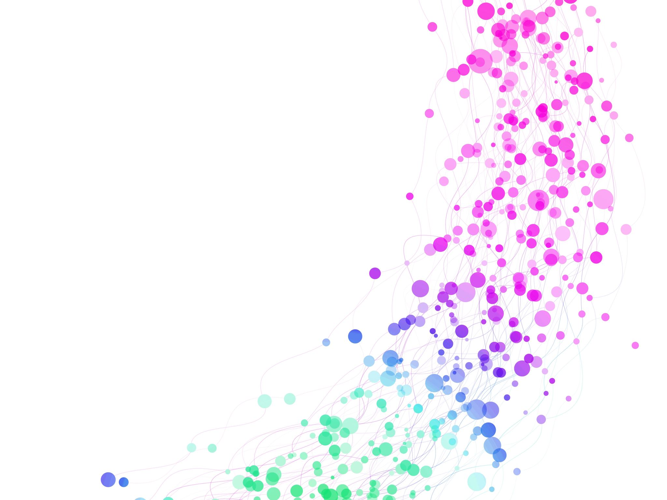
PencilPlay
Draw, Create, and Play, PencilPlay - Where Fun Meets Artistry!

Slide 2

Objective and Key feature
Develop a kid-friendly web/mobile app
Enable users to upload images and convert them into pencil sketches using AI
Enhance interactivity with features like colorization, rotation, translation, and voice commands

Slide 3

Software Technology and AI Agent:
Software: Utilize web technologies like HTML/CSS, React (or Angular), and Python (with Flask or Django) for web app development. For mobile apps, consider React Native or Flutter.
AI Agent: Implement AI algorithms using deep learning frameworks like TensorFlow or PyTorch for image-to-sketch conversion. Incorporate speech recognition libraries or APIs such as Google Cloud Speech-to-Text or Microsoft Azure Speech Service for voice-activated commands.

Slide 4

The BOYS: Image To Pencil Sketch App
Product Manager – Marcos Bittencourt
Team Lead – Simranjeet Singh (100854757)
Team Member – Mohammed Anas Teli (100906944)
Team Member – Faizan Shaikh (100898068)

